Slide 1
Library Organization System
Lizbeth Sanchez
Intro to Computer Science COP 1500 – CRN 80598
Instructor: Dr. Deepa Devasenapathy

Slide 2
Goal and Software Requirements
My goal for this project is too be able to find a way to add a new organization material to the original code and combine interest for people that enjoy books and Python.
PyCharm
Notes:
Combine my interest: This is because all the things I’ve learned in this class are very important and since I’m still new to Python I wanted to make my goal of adding concepts to the original code realistic and attainable.

Slide 3
Why I Chose This Project
Added Concepts
I chose this project concept because reading is one of my favorite hobbies and wanted to combine what I’ve learned in class to my other interest.
I wanted to create a project that I know I could understand and was within my abilities and knowledge.
The original code had 4 choices, so I added a 5th choice where you are able to view the books you’ve “borrowed.”
Notes:
I’ll show right now the original code and the concept I added

Slide 4
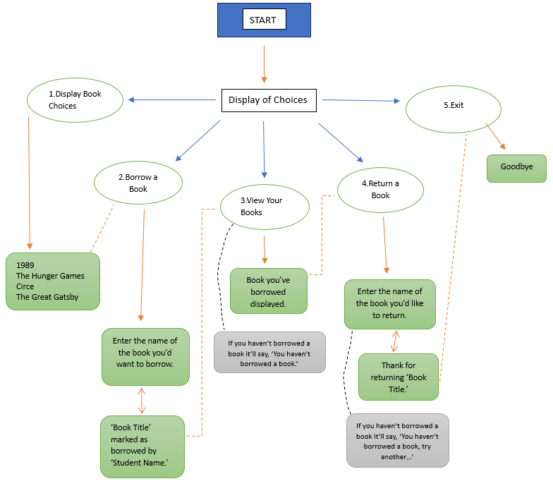
Flow Diagram

Slide 5
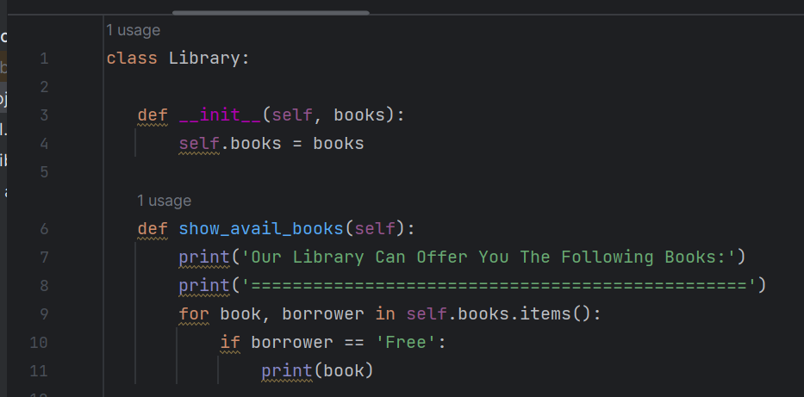
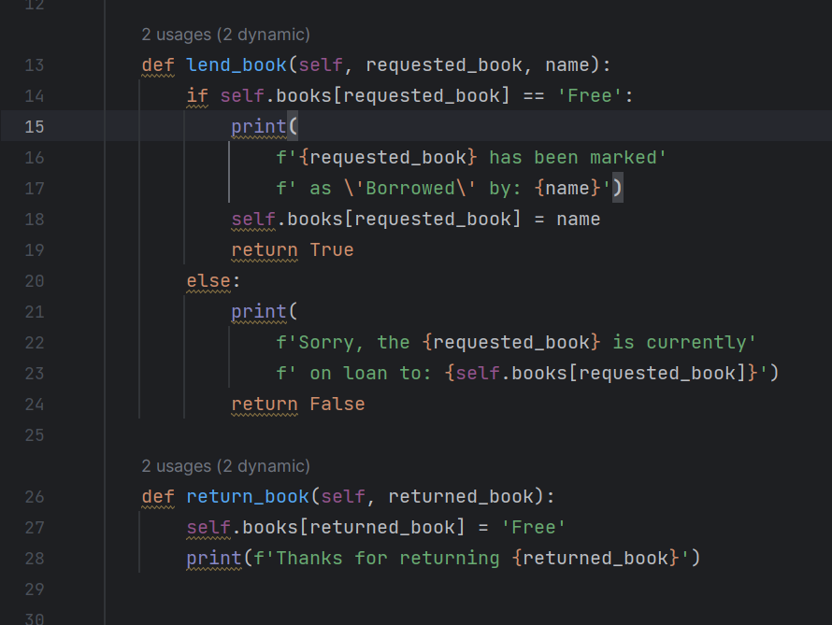
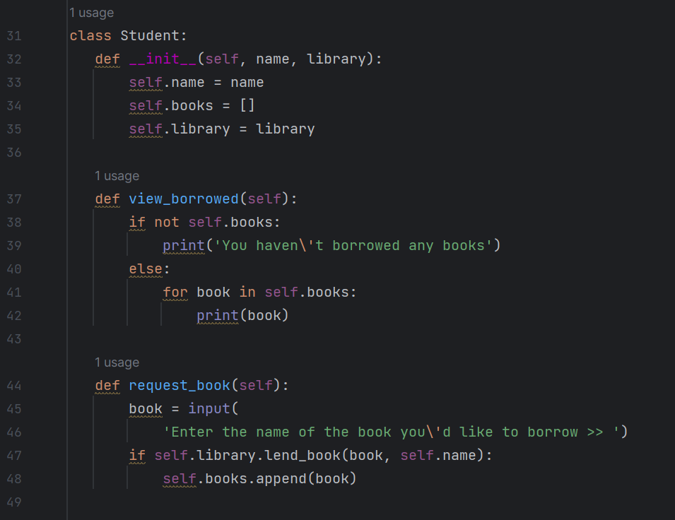
Screen Shots of Code

Slide 6
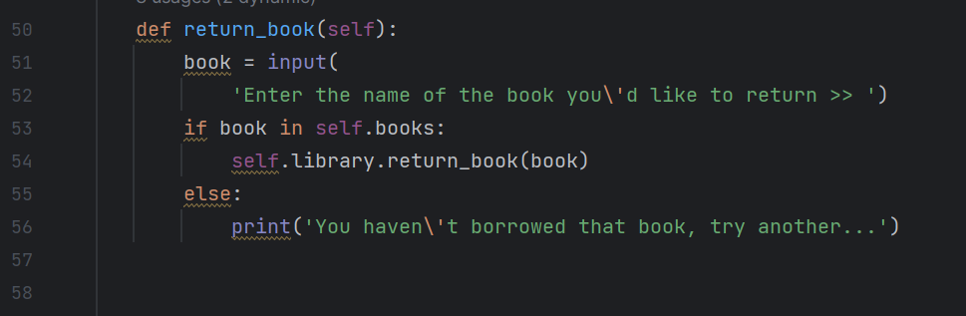
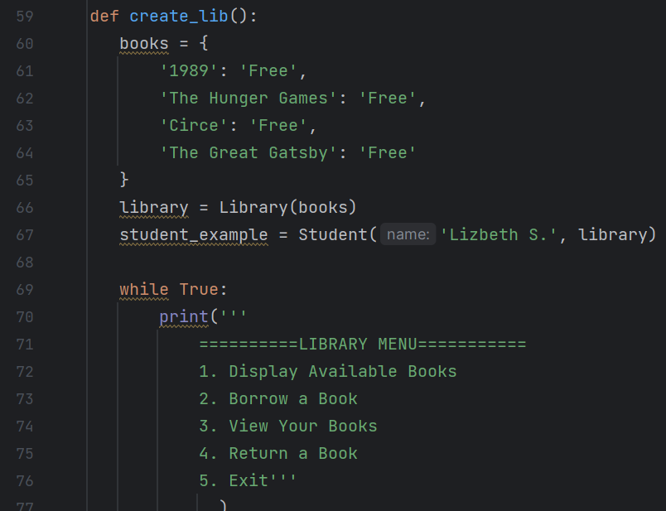
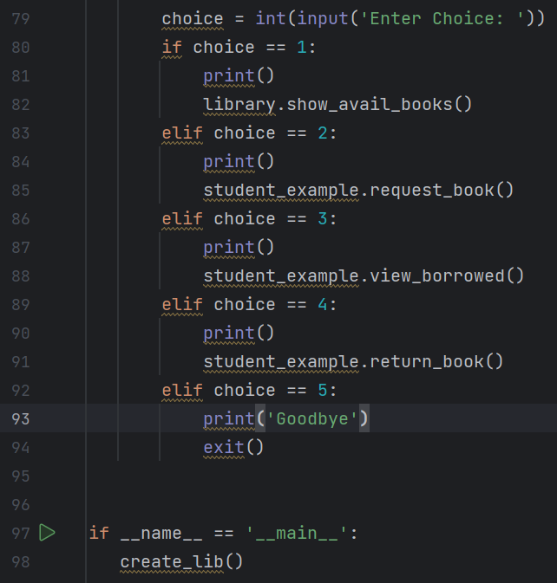
More Screen Shots

Slide 7
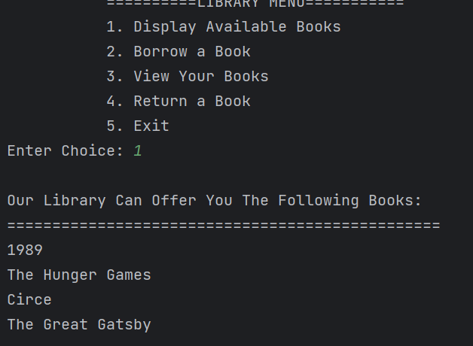
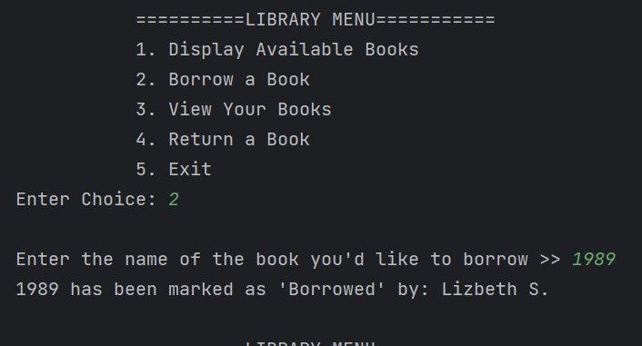
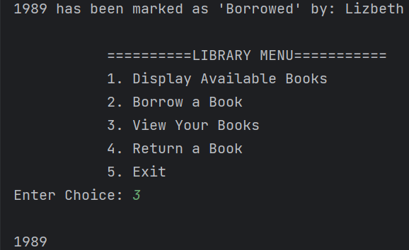
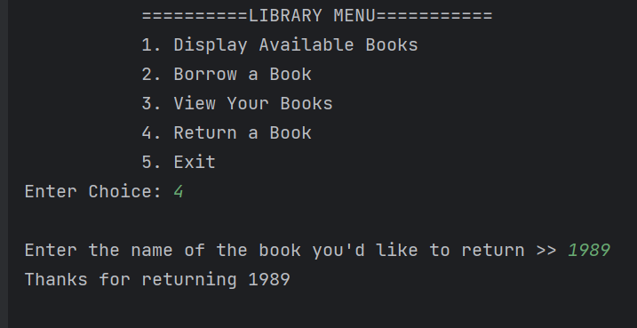
Outputs

Slide 8
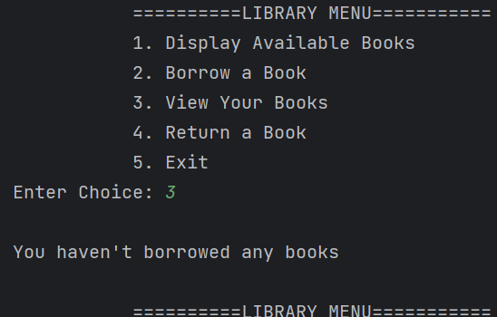
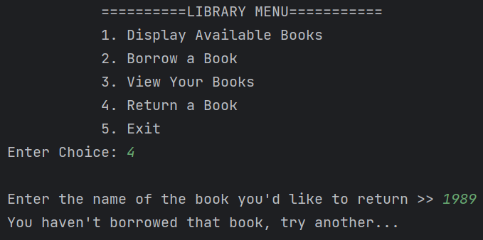
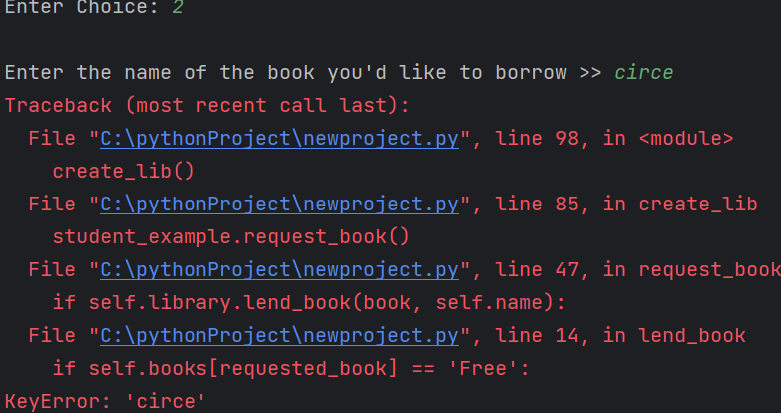
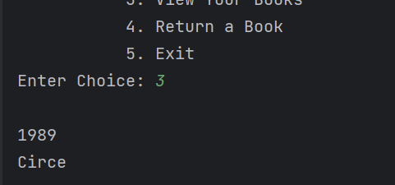
More Outputs

Slide 9
Resources
https://hackr.io/blog/python-projects
(356) How to Create Your Own Library System in Python - YouTube

Slide 10
Questions?

